Slide 1
ON412
Understanding Wired and Wireless Networks
Week 5
Notes:
1

Slide 2
Types of Networks
Networks can be categorized based on geographical span (LAN, MAN, WAN), structure (client-server, peer-to-peer), and type of connections (wired, wireless).
Notes:
2

Slide 3
The Power of
Wired Networks
3
Notes:
3

Slide 4
Wired networks use physical cables to connect devices.
Types of Cables:
Coaxial Cables: Used for high-frequency signals, with thick-net and thin-net variations.
Twisted-Pair Cables: Includes unshielded (UTP) and shielded (STP) types, commonly used in LANs.
Fiber Optic Cables: Transmit data as light signals, offering high speed and long-distance capabilities.
4
Notes:
4

Slide 5

Advantages of Wired Networks
Reliability: less interference and stable connections.
Speed: generally faster data transfer rates.
Security: more secure as physical access is required to tap into the network.
5
Notes:
5

Slide 6
Disadvantages of Wired Networks
Installation: More complex and expensive to install.
Mobility: Limited by the length of the cables.
Maintenance: Physical wear and tear can lead to issues.
6
Notes:
6

Slide 7
The Power of
Wireless Networks
7
Notes:
7

Slide 8
Wireless networks use radio waves to connect devices.
Types of Wireless Technologies:
Wi-Fi: Commonly used in homes and businesses for internet access.
Bluetooth: Short-range communication between devices.
Cellular Networks: Used for mobile phone communication and internet access3.
8
Notes:
8

Slide 9
Advantages of Wireless Networks
Mobility: Allows devices to connect from anywhere within the coverage area.
Ease of Installation: No need for physical cables.
Scalability: Easier to expand the network.
9
Notes:
9

Slide 10
Disadvantages of Wireless Networks
Interference: Susceptible to interference from other devices and physical obstacles.
Security: More vulnerable to unauthorized access and hacking.
Speed: Generally slower than wired networks.
10
Notes:
10

Slide 11
CSMA/CA
Carrier Sense Multiple Access/Collision Avoidance
Notes:
11

Slide 12
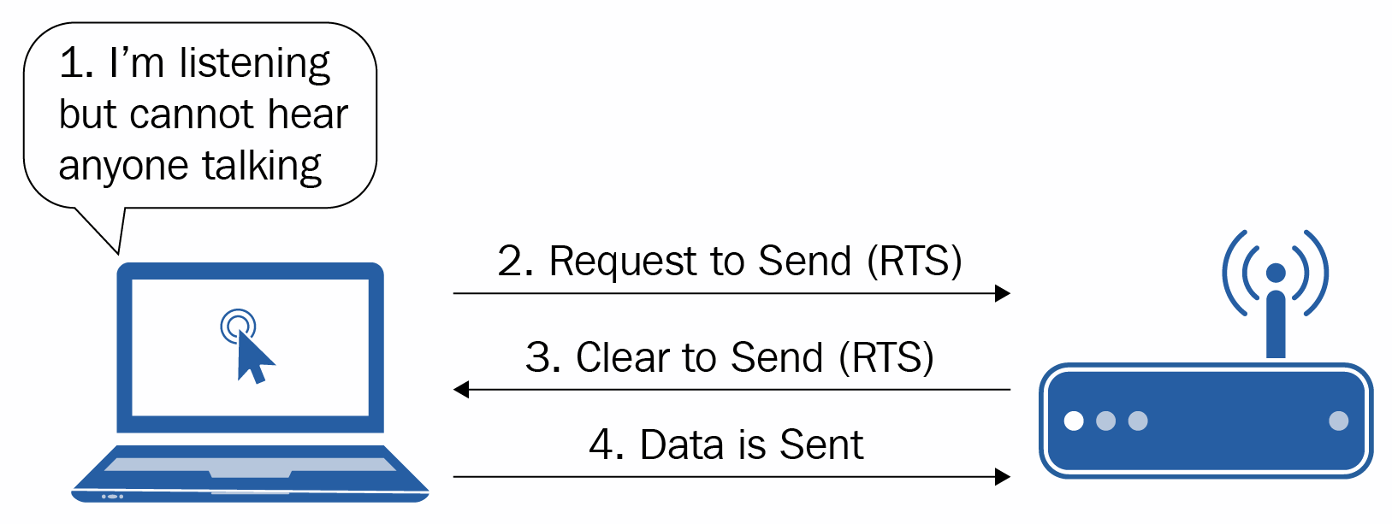
How does the csma/ca work?
CSMA/CA is a network protocol used in Wi-Fi networks to manage how data is transmitted over the airwaves and to avoid collisions.
12
Notes:
12

Slide 13
How does the csma/ca work?
Carrier Sense: Before transmitting, a device listens to the airwaves to check if another device is transmitting or to check if a channel is free before it starts sending its own data.
Multiple Access: The airwaves are shared among multiple devices, allowing them to access the network simultaneously, if there is coordination of signals.
Collision Avoidance: To prevent collisions, devices use a random backoff time. If a collision is detected, the device waits for a random period before attempting to retransmit.
13
Notes:
13

Slide 14
RTS/CTS
Ready To Send/Clear To Send
Notes:
14

Slide 15
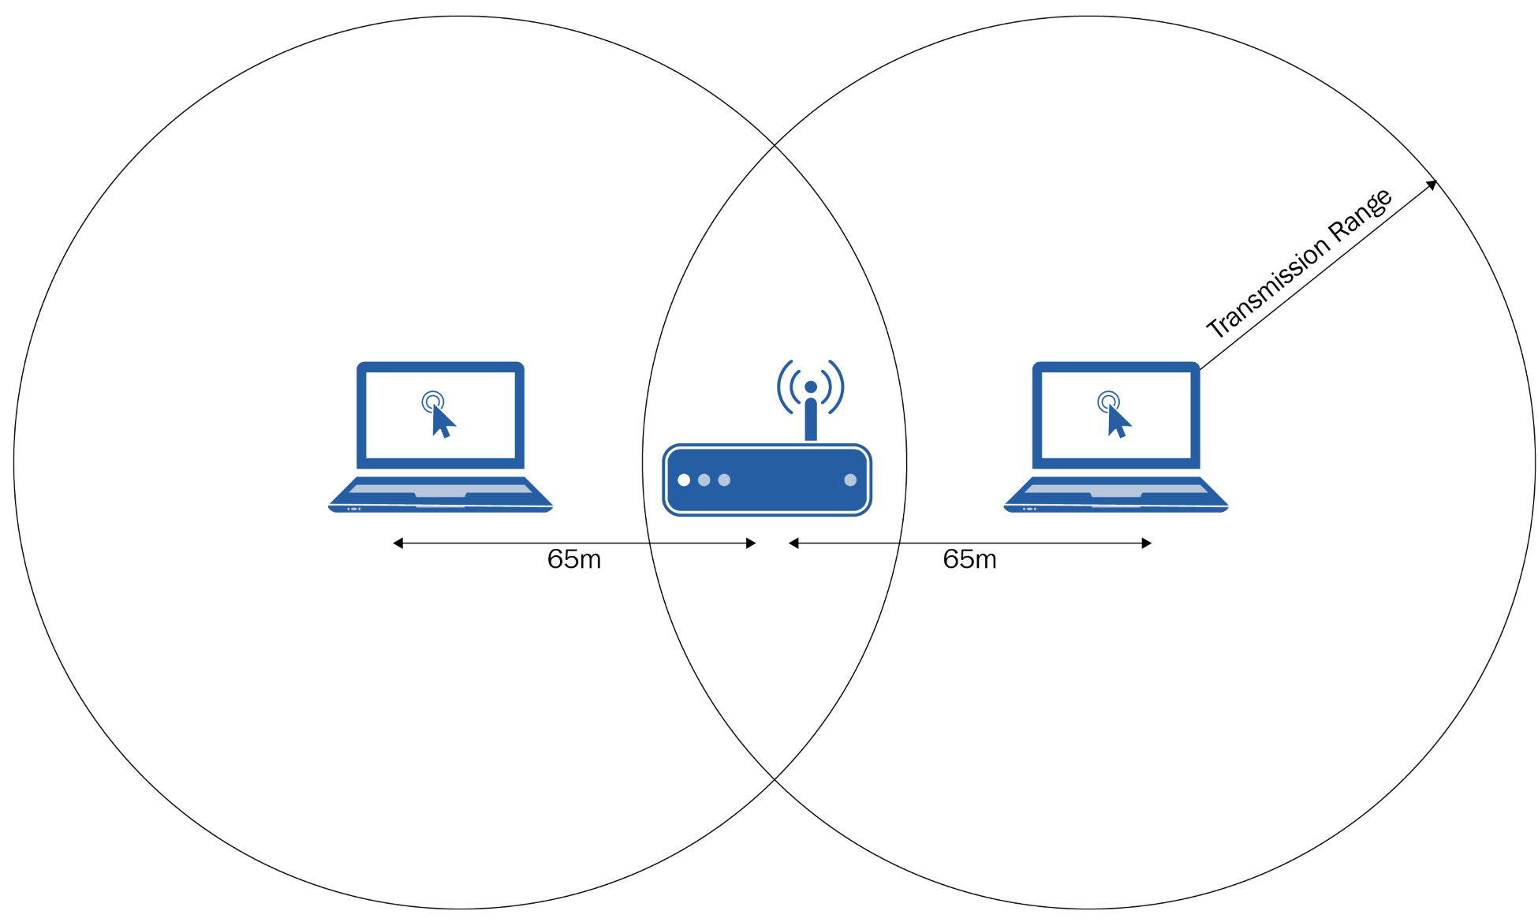
How does the RTS/CTS work?
RTS/CTS is a mechanism used in wireless networks to further reduce the chance of collisions by coordinating the transmission of data between devices.
15
Notes:
15

Slide 16
How does RTS/CTS work?
Request to Send (RTS): When a device wants to transmit data, it first sends a small control packet called RTS to the receiving device.
Clear to Send (CTS): Upon receiving the RTS packet, the receiving device checks if it is ready to receive data. If it is, it sends back a CTS packet.
Data Transmission: After receiving the CTS packet, the sending device can begin transmitting the actual data.
Acknowledgment (ACK): Once the data is successfully received, the receiving device sends an acknowledgment (ACK) packet back to the sender.
16
Notes:
16

Slide 17
Comparison of Wired and Wireless Networks
Performance: Wired networks typically offer higher performance and reliability.
Cost: Wireless networks can be more cost-effective in terms of installation and expansion.
Use Cases: Wired networks are ideal for environments requiring high security and speed, while wireless networks are suitable for flexible and mobile use cases.
17
Notes:
17

Slide 18
Choosing the Right Network
The choice between wired and wireless networks depends on specific needs, including performance, cost, security, and mobility requirements.
Advances in technology continue to improve both wired and wireless networks, making them more efficient and secure.
Notes:
18

